Slide 1


High Performance Cluster Computing
Architectures and Systems
Hai Jin
Cluster and Grid Computing Lab

Slide 2
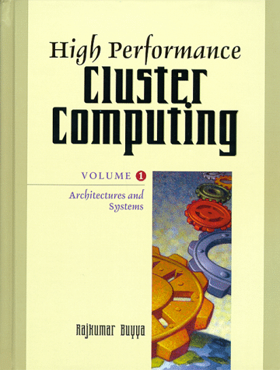
Cluster Computing at a Glance
  Introduction
  Scalable Parallel Computer Architecture
  Towards Low Cost Parallel Computing and Motivations
  Windows of Opportunity
  A Cluster Computer and its Architecture
  Clusters Classifications
  Commodity Components for Clusters
  Network Service/Communications SW
  Cluster Middleware and Single System Image
  Resource Management and Scheduling (RMS)
  Programming Environments and Tools
  Cluster Applications
  Representative Cluster Systems
  Cluster of SMPs (CLUMPS)
  Summary and Conclusions

Slide 3
Introduction
Need more computing power
  Improve the operating speed of processors & other components
    constrained by the speed of light, thermodynamic laws, & the high financial costs for processor fabrication
  Connect multiple processors together & coordinate their computational efforts
    parallel computers
    allow the sharing of a computational task among multiple processors

Slide 4
How to Run Applications Faster ?
There are 3 ways to improve performance:
  Work Harder
  Work Smarter
  Get Help
Computer Analogy
  Using faster hardware
  Optimized algorithms and techniques used to solve computational tasks
  Multiple computers to solve a particular task

Slide 5
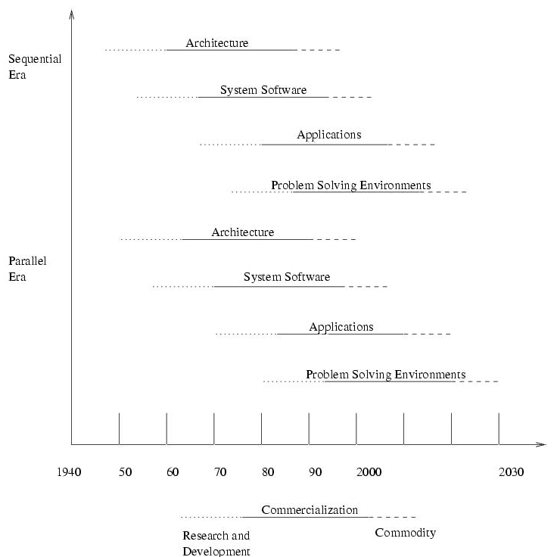
Two Eras of Computing

Slide 6
Scalable Parallel Computer Architectures
Taxonomy
  based on how processors, memory & interconnect are laid out
Massively Parallel Processors (MPP)
Symmetric Multiprocessors (SMP)
Cache-Coherent Nonuniform Memory Access (CC-NUMA)
Distributed Systems
Clusters

Slide 7
Scalable Parallel Computer Architectures
MPP
  A large parallel processing system with a shared-nothing architecture
  Consist of several hundred nodes with a high-speed interconnection network/switch
  Each node consists of a main memory & one or more processors
    Runs a separate copy of the OS
SMP
  2-64 processors today
  Shared-everything architecture
  All processors share all the global resources available
  Single copy of the OS runs on these systems

Slide 8
Scalable Parallel Computer Architectures
CC-NUMA
  a scalable multiprocessor system having a cache-coherent nonuniform memory access architecture
  every processor has a global view of all of the memory
Distributed systems
  considered conventional networks of independent computers
  have multiple system images as each node runs its own OS
  the individual machines could be combinations of MPPs, SMPs, clusters, & individual computers
Clusters
  a collection of workstations of PCs that are interconnected by a high-speed network
  work as an integrated collection of resources
  have a single system image spanning all its nodes

Slide 9
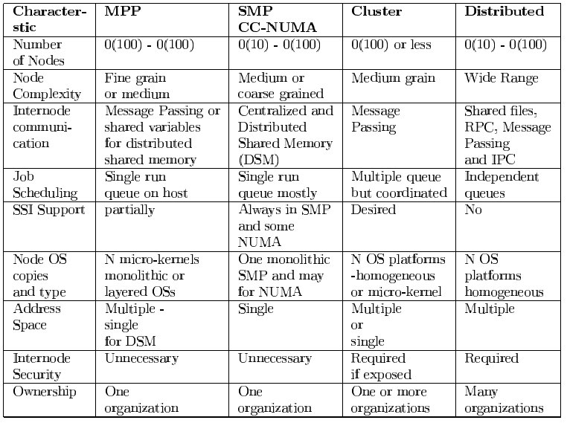
Key Characteristics of
Scalable Parallel Computers

Slide 10
Towards Low Cost Parallel Computing
Parallel processing
  linking together 2 or more computers to jointly solve some computational problem
  an increasing trend to move away from expensive and specialized proprietary parallel supercomputers towards networks of workstations
  the rapid improvement in the availability of commodity high performance components for workstations and networks
     Low-cost commodity supercomputing
  from specialized traditional supercomputing platforms to cheaper, general purpose systems consisting of loosely coupled components built up from single or multiprocessor PCs or workstations
  need to standardization of many of the tools and utilities used by parallel applications (ex) MPI, HPF

Slide 11
Motivations of using NOW over Specialized Parallel Computers
Individual workstations are becoming increasing powerful
Communication bandwidth between workstations is increasing and latency is decreasing
Workstation clusters are easier to integrate into existing networks
Typical low user utilization of personal workstations
Development tools for workstations are more mature
Workstation clusters are a cheap and readily available
Clusters can be easily grown

Slide 12
Trend
Workstations with UNIX for science & industry vs PC-based machines for administrative work & word processing
A rapid convergence in processor performance and kernel-level functionality of UNIX workstations and PC-based machines

Slide 13
Windows of Opportunities
Parallel Processing
  Use multiple processors to build MPP/DSM-like systems for parallel computing
Network RAM
  Use memory associated with each workstation as aggregate DRAM cache
Software RAID
  Redundant array of inexpensive disks
  Possible to provide parallel I/O support to applications
  Use arrays of workstation disks to provide cheap, highly available, and scalable file storage
Multipath Communication
  Use multiple networks for parallel data transfer between nodes

Slide 14
Cluster Computer and its Architecture
A cluster is a type of parallel or distributed processing system, which consists of a collection of interconnected stand-alone computers cooperatively working together as a single, integrated computing resource
A node
  a single or multiprocessor system with memory, I/O facilities, & OS
  generally 2 or more computers (nodes) connected together
  in a single cabinet, or physically separated & connected via a LAN
  appear as a single system to users and applications
  provide a cost-effective way to gain features and benefits

Slide 15
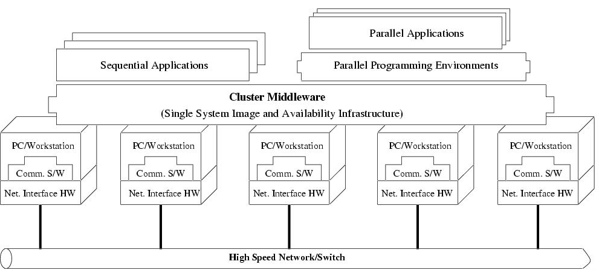
Cluster Computer Architecture

Slide 16
Prominent Components of
Cluster Computers (I)
Multiple High Performance Computers
  PCs
  Workstations
  SMPs (CLUMPS)
  Distributed HPC Systems leading to Metacomputing

Slide 17
Prominent Components of
Cluster Computers (II)
State of the art Operating Systems
  Linux (Beowulf)
  Microsoft NT (Illinois HPVM)
  SUN Solaris (Berkeley NOW)
  IBM AIX (IBM SP2)
  HP UX (Illinois - PANDA)
  Mach (Microkernel based OS) (CMU)
  Cluster Operating Systems (Solaris MC, SCO Unixware, MOSIX (academic project))
  OS gluing layers (Berkeley Glunix)

Slide 18
Prominent Components of
Cluster Computers (III)
High Performance Networks/Switches
  Ethernet (10Mbps)
  Fast Ethernet (100Mbps)
  Gigabit Ethernet (1Gbps)
  SCI (Dolphin - MPI- 12micro-sec latency)
  Myrinet (2Gbps)
  Infiniband (10Gbps)
  ATM
  Digital Memory Channel
  FDDI

Slide 19
Prominent Components of
Cluster Computers (IV)
Network Interface Card
  Myrinet has NIC
  User-level access support

Slide 20
Prominent Components of
Cluster Computers (V)
Fast Communication Protocols and Services
  Active Messages (Berkeley)
  Fast Messages (Illinois)
  U-net (Cornell)
  XTP (Virginia)

Slide 21
Prominent Components of
Cluster Computers (VI)
Cluster Middleware
  Single System Image (SSI)
  System Availability (SA) Infrastructure
Hardware
  DEC Memory Channel, DSM (Alewife, DASH), SMP Techniques
Operating System Kernel/Gluing Layers
  Solaris MC, Unixware, GLUnix
Applications and Subsystems
  Applications (system management and electronic forms)
  Runtime systems (software DSM, PFS etc.)
  Resource management and scheduling software (RMS)
    CODINE, LSF, PBS, NQS, etc.

Slide 22
Prominent Components of
Cluster Computers (VII)
Parallel Programming Environments and Tools
  Threads (PCs, SMPs, NOW..)
    POSIX Threads
    Java Threads
  MPI
    Linux, NT, on many Supercomputers
  PVM
  Software DSMs (Shmem)
  Compilers
    C/C++/Java
    Parallel programming with C++ (MIT Press book)
  RAD (rapid application development tools)
    GUI based tools for PP modeling
  Debuggers
  Performance Analysis Tools
  Visualization Tools

Slide 23
Prominent Components of
Cluster Computers (VIII)
Applications
  Sequential
  Parallel / Distributed (Cluster-aware app.)
    Grand Challenging applications
      Weather Forecasting
      Quantum Chemistry
      Molecular Biology Modeling
      Engineering Analysis (CAD/CAM)
      ……………….
    PDBs, web servers, data-mining

Slide 24
Key Operational Benefits of Clustering
High Performance
Expandability and Scalability
High Throughput
High Availability

Slide 25
Clusters Classification (I)
Application Target
  High Performance (HP) Clusters
    Grand challenging applications
  High Availability (HA) Clusters
    Mission critical applications

Slide 26
Clusters Classification (II)
Node Ownership
  Dedicated Clusters
  Non-dedicated clusters
    Adaptive parallel computing
    Communal multiprocessing

Slide 27
Clusters Classification (III)
Node Hardware
  Clusters of PCs (CoPs)
    Piles of PCs (PoPs)
  Clusters of Workstations (COWs)
  Clusters of SMPs (CLUMPs)

Slide 28
Clusters Classification (IV)
Node Operating System
  Linux Clusters (e.g., Beowulf)
  Solaris Clusters (e.g., Berkeley NOW)
  NT Clusters (e.g., HPVM)
  AIX Clusters (e.g., IBM SP2)
  SCO/Compaq Clusters (Unixware)
  Digital VMS Clusters
  HP-UX clusters
  Microsoft Wolfpack clusters

Slide 29
Clusters Classification (V)
Node Configuration
  Homogeneous Clusters
    All nodes have similar architectures and run the same OSs
  Heterogeneous Clusters
    All nodes have different architectures and run different OSs

Slide 30
Clusters Classification (VI)
Levels of Clustering
  Group Clusters (#nodes: 2-99)
    Nodes are connected by SAN like Myrinet
  Departmental Clusters (#nodes: 10s to 100s)
  Organizational Clusters (#nodes: many 100s)
  National Metacomputers (WAN/Internet-based)
  International Metacomputers (Internet-based, #nodes: 1000s to many millions)
    Metacomputing
    Web-based Computing
    Agent Based Computing
      Java plays a major in web and agent based computing

Slide 31
Commodity Components for Clusters (I)
Processors
  Intel x86 Processors
    Pentium Pro, Pentium Xeon
    AMD x86, Cyrix x86, etc.
  Digital Alpha
    Alpha 21364 processor integrates processing, memory controller, network interface into a single chip
  IBM PowerPC
  Sun SPARC
  SGI MIPS
  HP PA
  Berkeley Intelligent RAM (IRAM) integrates processor and DRAM onto a single chip

Slide 32
Commodity Components for Clusters (II)
Memory and Cache
  Standard Industry Memory Module (SIMM)
  Extended Data Out (EDO)
    Allow next access to begin while the previous data is still being read
  Fast page
    Allow multiple adjacent accesses to be made more efficiently
  Access to DRAM is extremely slow compared to the speed of the processor
    the very fast memory used for Cache is expensive & cache control circuitry becomes more complex as the size of the cache grows
  Within Pentium-based machines, common to have a 64-bit wide memory bus as well as a chip set that support 2Mbytes of external cache

Slide 33
Commodity Components for Clusters (III)
Disk and I/O
  Overall improvement in disk access time has been less than 10% per year
  Amdahl’s law
    Speed-up obtained by from faster processors is limited by the slowest system component
  Parallel I/O
    Carry out I/O operations in parallel, supported by parallel file system based on hardware or software RAID

Slide 34
Commodity Components for Clusters (IV)
System Bus
  ISA bus (AT bus)
    Clocked at 5MHz and 8 bits wide
    Clocked at 13MHz and 16 bits wide
  VESA bus
    32 bits bus matched system’s clock speed
  PCI bus
    133Mbytes/s transfer rate
    Adopted both in Pentium-based PC and non-Intel platform (e.g., Digital Alpha Server)

Slide 35
Commodity Components for Clusters (V)
Cluster Interconnects
  Communicate over high-speed networks using a standard networking protocol such as TCP/IP or a low-level protocol such as AM
  Standard Ethernet
    10 Mbps
    cheap, easy way to provide file and printer sharing
    bandwidth & latency are not balanced with the computational power
  Ethernet, Fast Ethernet, and Gigabit Ethernet
    Fast Ethernet – 100 Mbps
    Gigabit Ethernet
      preserve Ethernet’s simplicity
      deliver a very high bandwidth to aggregate multiple Fast Ethernet segments

Slide 36
Commodity Components for Clusters (VI)
Cluster Interconnects
  Asynchronous Transfer Mode (ATM)
    Switched virtual-circuit technology
    Cell (small fixed-size data packet)
    use optical fiber - expensive upgrade
    telephone style cables (CAT-3) & better quality cable (CAT-5)
  Scalable Coherent Interfaces (SCI)
    IEEE 1596-1992 standard aimed at providing a low-latency distributed shared memory across a cluster
    Point-to-point architecture with directory-based cache coherence
      reduce the delay of interprocessor communication
      eliminate the need for runtime layers of software protocol-paradigm translation
      less than 12 usec zero message-length latency on Sun SPARC
    Designed to support distributed multiprocessing with high bandwidth and low latency
    SCI cards for SPARC’s SBus and PCI-based SCI cards from Dolphin
    Scalability constrained by the current generation of switches & relatively expensive components

Slide 37
Commodity Components for Clusters (VII)
Cluster Interconnects
  Myrinet
    1.28 Gbps full duplex interconnection network
    Use low latency cut-through routing switches, which is able to offer fault tolerance by automatic mapping of the network configuration
    Support both Linux & NT
    Advantages
      Very low latency (5μs, one-way point-to-point)
      Very high throughput
      Programmable on-board processor for greater flexibility
    Disadvantages
      Expensive: $1500 per host
      Complicated scaling: switches with more than 128 ports are unavailable

Slide 38
Commodity Components for Clusters (VIII)
Operating Systems
  2 fundamental services for users
    make the computer hardware easier to use
      create a virtual machine that differs markedly from the real machine
    share hardware resources among users
      Processor - multitasking
  The new concept in OS services
    support multiple threads of control in a process itself
      parallelism within a process
      multithreading
      POSIX thread interface is a standard programming environment
  Trend
    Modularity – MS Windows, IBM OS/2
    Microkernel – provide only essential OS services
      high level abstraction of OS portability

Slide 39
Commodity Components for Clusters (IX)
Operating Systems
  Linux
    UNIX-like OS
    Runs on cheap x86 platform, yet offers the power and flexibility of UNIX
    Readily available on the Internet and can be downloaded without cost
    Easy to fix bugs and improve system performance
    Users can develop or fine-tune hardware drivers which can easily be made available to other users
    Features such as preemptive multitasking, demand-page virtual memory, multiuser, multiprocessor support

Slide 40
Commodity Components for Clusters (X)
Operating Systems
  Solaris
    UNIX-based multithreading and multiuser OS
    Support Intel x86 & SPARC-based platforms
    Real-time scheduling feature critical for multimedia applications
    Support two kinds of threads
      Light Weight Processes (LWPs)
      User level thread
    Support both BSD and several non-BSD file system
      CacheFS
      AutoClient
      TmpFS: uses main memory to contain a file system
      Proc file system
      Volume file system
    Support distributed computing & is able to store & retrieve distributed information
    OpenWindows allows application to be run on remote systems

Slide 41
Commodity Components for Clusters (XI)
Operating Systems
  Microsoft Windows NT (New Technology)
    Preemptive, multitasking, multiuser, 32-bits OS
    Object-based security model and special file system (NTFS) that allows permissions to be set on a file and directory basis
    Support multiple CPUs and provide multitasking using symmetrical multiprocessing
    Support different CPUs and multiprocessor machines with threads
    Have the network protocols & services integrated with the base OS
      several built-in networking protocols (IPX/SPX., TCP/IP, NetBEUI), & APIs (NetBIOS, DCE RPC, Window Sockets (Winsock))

Slide 42
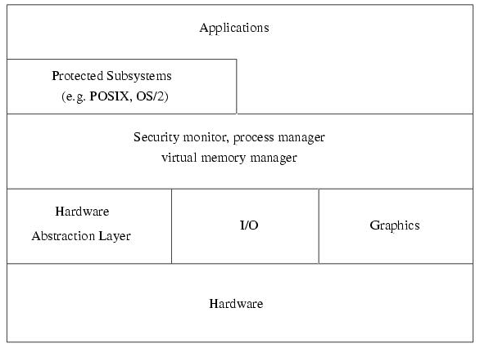
Windows NT 4.0 Architecture

Slide 43
Network Services/ Communication SW
Communication infrastructure support protocol for
  Bulk-data transport
  Streaming data
  Group communications
Communication service provide cluster with important QoS parameters
  Latency
  Bandwidth
  Reliability
  Fault-tolerance
  Jitter control
Network service are designed as hierarchical stack of protocols with relatively low-level communication API, provide means to implement wide range of communication methodologies
  RPC
  DSM
  Stream-based and message passing interface (e.g., MPI, PVM)

Slide 44
Cluster Middleware & SSI
SSI
  Supported by a middleware layer that resides between the OS and user-level environment
  Middleware consists of essentially 2 sublayers of SW infrastructure
    SSI infrastructure
      Glue together OSs on all nodes to offer unified access to system resources
    System availability infrastructure
      Enable cluster services such as checkpointing, automatic failover, recovery from failure, & fault-tolerant support among all nodes of the cluster

Slide 45
What is Single System Image (SSI) ?
A single system image is the illusion, created by software or hardware, that presents a collection of resources as one, more powerful resource
SSI makes the cluster appear like a single machine to the user, to applications, and to the network
A cluster without a SSI is not a cluster

Slide 46
Single System Image Boundaries
Every SSI has a boundary
SSI support can exist at different levels within a system, one able to be build on another

Slide 47
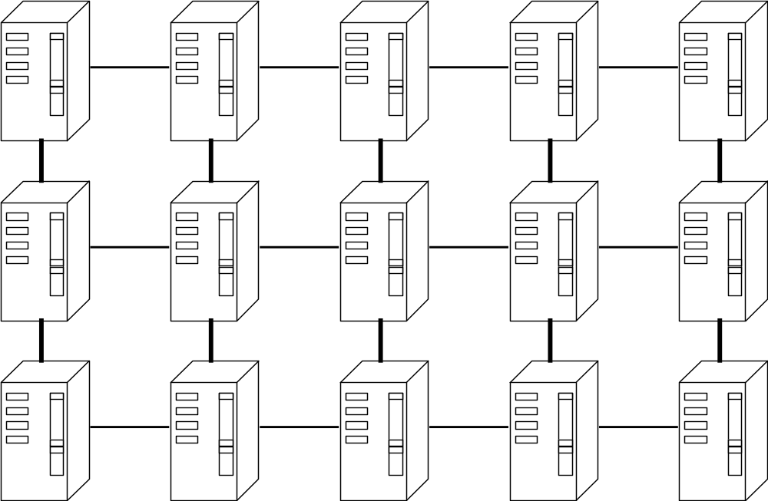
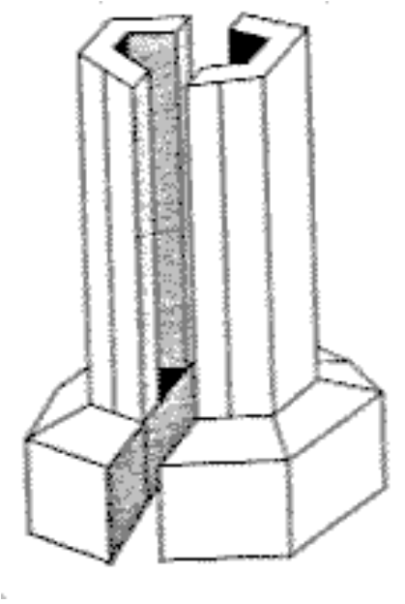
SSI Boundaries -- an applications SSI boundary
Batch System
SSI
Boundary
(c) In search
of clusters

Slide 48
SSI Levels/Layers
Application and Subsystem Level
Operating System Kernel Level
Hardware Level

Slide 49
SSI at Hardware Layer
Level
Examples
Boundary
Importance
Application and Subsystem Level
Operating System Kernel Level
memory
SCI, DASH
memory space
better communica-
tion and synchro-
nization
memory
and I/O
SCI, SMP techniques
memory and I/O
device space
lower overhead
cluster I/O
(c) In search of clusters

Slide 50
SSI at Operating System Kernel (Underware) or Gluing Layer
Level
Examples
Boundary
Importance
Kernel/
OS Layer
Solaris MC, Unixware
MOSIX, Sprite, Amoeba
/ GLUnix
each name space:
files, processes,
pipes, devices, etc.
kernel support for
applications, adm
subsystems
kernel
interfaces
UNIX (Sun) vnode,
Locus (IBM) vproc
type of kernel
objects: files,
processes, etc.
modularizes SSI
code within
kernel
virtual
memory
none supporting
operating system kernel
each distributed
virtual memory
space
may simplify
implementation
of kernel objects
microkernel
Mach, PARAS, Chorus,
OSF/1AD, Amoeba
each service
outside the
microkernel
implicit SSI for
all system services
(c) In search of clusters

Slide 51
SSI at Application and Subsystem Layer (Middleware)
Level
Examples
Boundary
Importance
application
cluster batch system,
system management
an application
what a user
wants
subsystem
distributed DB,
OSF DME, Lotus
Notes, MPI, PVM
a subsystem
SSI for all
applications of
the subsystem
file system
Sun NFS, OSF,
DFS, NetWare,
and so on
shared portion of
the file system
implicitly supports
many applications
and subsystems
toolkit
OSF DCE, Sun
ONC+, Apollo
Domain
explicit toolkit
facilities: user,
service name,time
best level of
support for heter-
ogeneous system
(c) In search of clusters

Slide 52
Single System Image Benefits
Provide a simple, straightforward view of all system resources and activities, from any node of the cluster
Free the end user from having to know where an application will run
Free the operator from having to know where a resource is located
Let the user work with familiar interface and commands and allows the administrators to manage the entire clusters as a single entity
Reduce the risk of operator errors, with the result that end users see improved reliability and higher availability of the system

Slide 53
Single System Image Benefits (Cont’d)
Allowing centralize/decentralize system management and control to avoid the need of skilled administrators from system administration
Present multiple, cooperating components of an application to the administrator as a single application
Greatly simplify system management
Provide location-independent message communication
Help track the locations of all resource so that there is no longer any need for system operators to be concerned with their physical location
Provide transparent process migration and load balancing across nodes.
Improved system response time and performance

Slide 54
Middleware Design Goals
Complete Transparency in Resource Management
  Allow user to use a cluster easily without the knowledge of the underlying system architecture
  The user is provided with the view of a globalized file system, processes, and network
Scalable Performance
  Can easily be expanded, their performance should scale as well
  To extract the max performance, the SSI service must support load balancing & parallelism by distributing workload evenly among nodes
Enhanced Availability
  Middleware service must be highly available at all times
  At any time, a point of failure should be recoverable without affecting a user’s application
    Employ checkpointing & fault tolerant technologies
  Handle consistency of data when replicated

Slide 55

SSI Support Services
Single Entry Point
  telnet cluster.myinstitute.edu
  telnet node1.cluster. myinstitute.edu
Single File Hierarchy: xFS, AFS, Solaris MC Proxy
Single Management and Control Point: Management from single GUI
Single Virtual Networking
Single Memory Space - Network RAM / DSM
Single Job Management: GLUnix, Codine, LSF
Single User Interface: Like workstation/PC windowing environment (CDE in Solaris/NT), may it can use Web technology

Slide 56
Availability Support Functions
Single I/O Space (SIOS)
  Any node can access any peripheral or disk devices without the knowledge of physical location
Single Process Space (SPS)
  Any process on any node create process with cluster wide process and they communicate through signal, pipes, etc, as if they are one a single node
Checkpointing and Process Migration
  Saves the process state and intermediate results in memory to disk to support rollback recovery when node fails
  PM for dynamic load balancing among the cluster nodes

Slide 57
Resource Management and Scheduling (RMS)
RMS is the act of distributing applications among computers to maximize their throughput
Enable the effective and efficient utilization of the resources available
Software components
  Resource manager
    Locating and allocating computational resource, authentication, process creation and migration
  Resource scheduler
    Queueing applications, resource location and assignment
Reasons using RMS
  Provide an increased, and reliable, throughput of user applications on the systems
  Load balancing
  Utilizing spare CPU cycles
  Providing fault tolerant systems
  Manage access to powerful system, etc
Basic architecture of RMS: client-server system

Slide 58
Services provided by RMS
Process Migration
  Computational resource has become too heavily loaded
  Fault tolerant concern
Checkpointing
Scavenging Idle Cycles
  70% to 90% of the time most workstations are idle
Fault Tolerance
Minimization of Impact on Users
Load Balancing
Multiple Application Queues

Slide 59
Some Popular
Resource Management Systems
Project | Commercial Systems - URL
LSF | http://www.platform.com/
CODINE | http://www.genias.de/products/codine/tech_desc.html
Easy-LL | http://www.tc.cornell.edu/UserDoc/SP/LL12/Easy/
NQE | http://www.cray.com/products/software/nqe/
 | Public Domain System - URL
CONDOR | http://www.cs.wisc.edu/condor/
GNQS | http://www.gnqs.org/
DQS | http://www.scri.fsu.edu/~pasko/dqs.html
PRM | http://gost.isi.edu/gost-group/products/prm/
PBS | http://pbs.mrj.com/

Slide 60
Programming Environments and Tools (I)
Threads (PCs, SMPs, NOW..)
  In multiprocessor systems
    Used to simultaneously utilize all the available processors
  In uniprocessor systems
    Used to utilize the system resources effectively
  Multithreaded applications offer quicker response to user input and run faster
  Potentially portable, as there exists an IEEE standard for POSIX threads interface (pthreads)
  Extensively used in developing both application and system software

Slide 61
Programming Environments and Tools (II)
Message Passing Systems (MPI and PVM)
  Allow efficient parallel programs to be written for distributed memory systems
  2 most popular high-level message-passing systems – PVM & MPI
  PVM
    both an environment & a message-passing library
  MPI
    a message passing specification, designed to be standard for distributed memory parallel computing using explicit message passing
    attempt to establish a practical, portable, efficient, & flexible standard for message passing
    generally, application developers prefer MPI, as it is fast becoming the de facto standard for message passing

Slide 62
A Sample MPI Program
(master)
# include <stdio.h>
# include <string.h>
#include “mpi.h”
main( int argc, char *argv[ ])
{
int my_rank; /* process rank */
int p; /*no. of processes*/
int source; /* rank of sender */
int dest; /* rank of receiver */
int tag = 0; /* message tag, like “email subject” */
char message[100]; /* buffer */
MPI_Status status; /* function return status */
/* Start up MPI */
MPI_Init(&argc, &argv);
/* Find our process rank/id */
MPI_Comm_rank(MPI_COM_WORLD, &my_rank);
/*Find out how many processes/tasks part of this run */
MPI_Comm_size(MPI_COM_WORLD, &p);
Hello,...
…
(workers)
Notes:
14

Slide 63
A Sample MPI Program
if( my_rank == 0) /* Master Process */
{
for( source = 1; source < p; source++)
{
MPI_Recv(message, 100, MPI_CHAR, source, tag, MPI_COM_WORLD, &status);
printf(“%s \n”, message);
}
}
else /* Worker Process */
{
sprintf(message, “Hello, I am your worker process %d!”, my_rank );
dest = 0;
MPI_Send(message, strlen(message)+1, MPI_CHAR, dest, tag, MPI_COM_WORLD);
}
/* Shutdown MPI environment */
MPI_Finalise();
}
Notes:
14

Slide 64
Execution
% cc -o hello hello.c -lmpi
% mpirun -p2 hello
Hello, I am process 1!
% mpirun -p4 hello
Hello, I am process 1!
Hello, I am process 2!
Hello, I am process 3!
% mpirun hello
(no output, there are no workers.., no greetings)
Notes:
14

Slide 65
Programming Environments and Tools (III)
Distributed Shared Memory (DSM) Systems
  Message-passing
    the most efficient, widely used, programming paradigm on distributed memory system
    complex & difficult to program
  Shared memory systems
    offer a simple and general programming model
    but suffer from scalability
  DSM on distributed memory system
    alternative cost-effective solution
    Software DSM
      Usually built as a separate layer on top of the comm interface
      Take full advantage of the application characteristics: virtual pages, objects, & language types are units of sharing
      ThreadMarks, Linda
    Hardware DSM
      Better performance, no burden on user & SW layers, fine granularity of sharing, extensions of the cache coherence scheme, & increased HW complexity
      DASH, Merlin

Slide 66
Programming Environments and Tools (IV)
Parallel Debuggers and Profilers
  Debuggers
    Very limited
    HPDF (High Performance Debugging Forum) as Parallel Tools Consortium project in 1996
      Developed a HPD version specification, which defines the functionality, semantics, and syntax for a commercial-line parallel debugger
  TotalView
    A commercial product from Dolphin Interconnect Solutions
    The only widely available GUI-based parallel debugger that supports multiple HPC platforms
    Only used in homogeneous environments, where each process of the parallel application being debugged must be running under the same version of the OS

Slide 67
Functionality of Parallel Debugger
Managing multiple processes and multiple threads within a process
Displaying each process in its own window
Displaying source code, stack trace, and stack frame for one or more processes
Diving into objects, subroutines, and functions
Setting both source-level and machine-level breakpoints
Sharing breakpoints between groups of processes
Defining watch and evaluation points
Displaying arrays and its slices
Manipulating code variable and constants

Slide 68
Programming Environments and Tools (V)
Performance Analysis Tools
  Help a programmer to understand the performance characteristics of an application
  Analyze & locate parts of an application that exhibit poor performance and create program bottlenecks
  Major components
    A means of inserting instrumentation calls to the performance monitoring routines into the user’s applications
    A run-time performance library that consists of a set of monitoring routines
    A set of tools for processing and displaying the performance data
  Issue with performance monitoring tools
    Intrusiveness of the tracing calls and their impact on the application performance
    Instrumentation affects the performance characteristics of the parallel application and thus provides a false view of its performance behavior

Slide 69
Performance Analysis and Visualization Tools
Tool | Supports | URL
AIMS | Instrumentation, monitoring library, analysis | http://science.nas.nasa.gov/Software/AIMS
MPE | Logging library and snapshot performance visualization | http://www.mcs.anl.gov/mpi/mpich
Pablo | Monitoring library and analysis | http://www-pablo.cs.uiuc.edu/Projects/Pablo/
Paradyn | Dynamic instrumentation running analysis | http://www.cs.wisc.edu/paradyn
SvPablo | Integrated instrumentor, monitoring library and analysis | http://www-pablo.cs.uiuc.edu/Projects/Pablo/
Vampir | Monitoring library performance visualization | http://www.pallas.de/pages/vampir.htm
Dimenmas | Performance prediction for message passing programs | http://www.pallas.com/pages/dimemas.htm
Paraver | Program visualization and analysis | http://www.cepba.upc.es/paraver

Slide 70
Programming Environments and Tools (VI)
Cluster Administration Tools
  Berkeley NOW
    Gather & store data in a relational DB
    Use Java applet to allow users to monitor a system
  SMILE (Scalable Multicomputer Implementation using Low-cost Equipment)
    Called K-CAP
    Consist of compute nodes, a management node, & a client that can control and monitor the cluster
    K-CAP uses a Java applet to connect to the management node through a predefined URL address in the cluster
  PARMON
    A comprehensive environment for monitoring large clusters
    Use client-server techniques to provide transparent access to all nodes to be monitored
    parmon-server & parmon-client

Slide 71
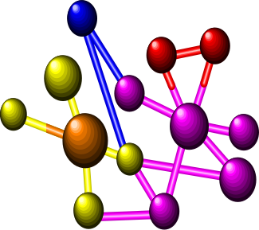








Need of more Computing Power:
Grand Challenge Applications
Solving technology problems using computer modeling, simulation and analysis
Geographic
Information
Systems
Life Sciences
Aerospace
CAD/CAM
Digital Biology
Military Applications

Slide 72
Representative Cluster Systems (I)
The Berkeley Network of Workstations (NOW) Project
  Demonstrate building of a large-scale parallel computer system using mass produced commercial workstations & the latest commodity switch-based network components
  Interprocess communication
    Active Messages (AM)
      basic communication primitives in Berkeley NOW
      A simplified remote procedure call that can be implemented efficiently on a wide range of hardware
  Global Layer Unix (GLUnix)
    An OS layer designed to provide transparent remote execution, support for interactive parallel & sequential jobs, load balancing, & backward compatibility for existing application binaries
    Aim to provide a cluster-wide namespace and uses Network PIDs (NPIDs), and Virtual Node Numbers (VNNs)

Slide 73
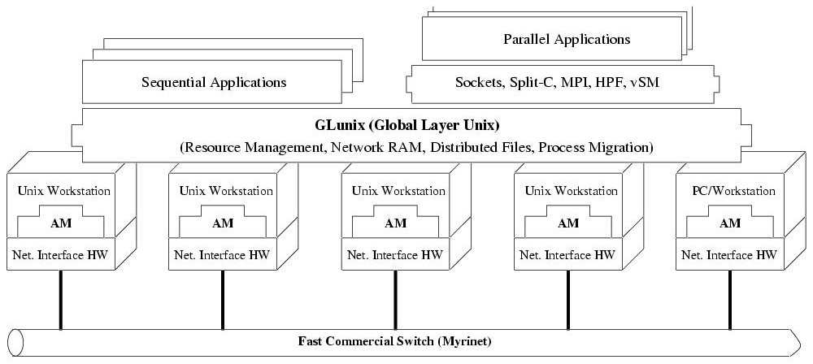
Architecture of NOW System

Slide 74
Representative Cluster Systems (II)
The Berkeley Network of Workstations (NOW) Project
  Network RAM
    Allow to utilize free resources on idle machines as a paging device for busy machines
    Serverless
      any machine can be a server when it is idle, or a client when it needs more memory than physically available
  xFS: Serverless Network File System
    A serverless, distributed file system, which attempt to have low latency, high bandwidth access to file system data by distributing the functionality of the server among the clients
    The function of locating data in xFS is distributed by having each client responsible for servicing requests on a subset of the files
    File data is striped across multiple clients to provide high bandwidth

Slide 75
Representative Cluster Systems (III)
The High Performance Virtual Machine (HPVM) Project
  Deliver supercomputer performance on a low cost COTS system
  Hide the complexities of a distributed system behind a clean interface
  Challenges addressed by HPVM
    Delivering high performance communication to standard, high-level APIs
    Coordinating scheduling and resource management
    Managing heterogeneity

Slide 76
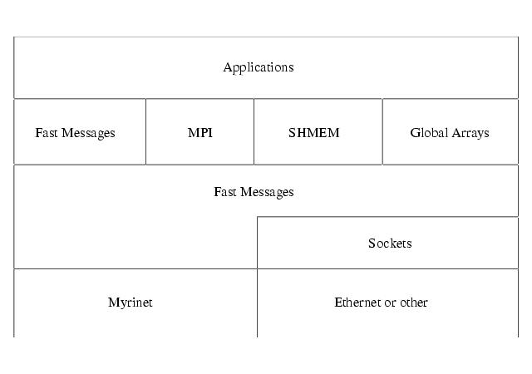
HPVM Layered Architecture

Slide 77
Representative Cluster Systems (IV)
The High Performance Virtual Machine (HPVM) Project
  Fast Messages (FM)
    A high bandwidth & low-latency comm protocol, based on Berkeley AM
    Contains functions for sending long and short messages & for extracting messages from the network
    Guarantees and controls the memory hierarchy
    Guarantees reliable and ordered packet delivery as well as control over the scheduling of communication work
    Originally developed on a Cray T3D & a cluster of SPARCstations connected by Myrinet hardware
    Low-level software interface that delivery hardware communication performance
    High-level layers interface offer greater functionality, application portability, and ease of use

Slide 78
Representative Cluster Systems (V)
The Beowulf Project
  Investigate the potential of PC clusters for performing computational tasks
  Refer to a Pile-of-PCs (PoPC) to describe a loose ensemble or cluster of PCs
  Emphasize the use of mass-market commodity components, dedicated processors, and the use of a private communication network
  Achieve the best overall system cost/performance ratio for the cluster

Slide 79
Representative Cluster Systems (VI)
The Beowulf Project
  System Software
    Grendel
      the collection of software tools
      resource management & support distributed applications
    Communication
      through TCP/IP over Ethernet internal to cluster
      employ multiple Ethernet networks in parallel to satisfy the internal data transfer bandwidth required
      achieved by ‘channel binding’ techniques
    Extend the Linux kernel to allow a loose ensemble of nodes to participate in a number of global namespaces
    Two Global Process ID (GPID) schemes
      Independent of external libraries
      GPID-PVM compatible with PVM Task ID format & uses PVM as its signal transport

Slide 80
Representative Cluster Systems (VII)
Solaris MC: A High Performance Operating System for Clusters
  A distributed OS for a multicomputer, a cluster of computing nodes connected by a high-speed interconnect
  Provide a single system image, making the cluster appear like a single machine to the user, to applications, and the the network
  Built as a globalization layer on top of the existing Solaris kernel
  Interesting features
    extends existing Solaris OS
    preserves the existing Solaris ABI/API compliance
    provides support for high availability
    uses C++, IDL, CORBA in the kernel
    leverages Spring technology

Slide 81
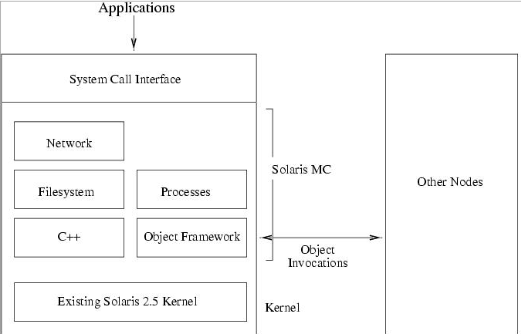
Solaris MC Architecture

Slide 82
Representative Cluster Systems (VIII)
Solaris MC: A High Performance Operating System for Clusters
  Use an object-oriented framework for communication between nodes
    Based on CORBA
    Provide remote object method invocations
    Provide object reference counting
    Support multiple object handlers
  Single system image features
    Global file system
      Distributed file system, called ProXy File System (PXFS), provides a globalized file system without need for modifying the existing file system
    Globalized process management
    Globalized network and I/O

Slide 83
Cluster System Comparison Matrix
Project | Platform | Communications | OS | Other
Beowulf | PCs | Multiple Ethernet with TCP/IP | Linux and Grendel | MPI/PVM. Sockets and HPF
Berkeley Now | Solaris-based PCs and workstations | Myrinet and Active Messages | Solaris + GLUnix + xFS | AM, PVM, MPI, HPF, Split-C
HPVM | PCs | Myrinet with Fast Messages | NT or Linux connection and global resource manager + LSF | Java-fronted, FM, Sockets, Global Arrays, SHEMEM and MPI
Solaris MC | Solaris-based PCs and workstations | Solaris-supported | Solaris + Globalization layer | C++ and CORBA

Slide 84
Cluster of SMPs (CLUMPS)
Clusters of multiprocessors (CLUMPS)
  To be the supercomputers of the future
  Multiple SMPs with several network interfaces can be connected using high performance networks
  2 advantages
    Benefit from the high performance, easy-to-use-and program SMP systems with a small number of CPUs
    Clusters can be set up with moderate effort, resulting in easier administration and better support for data locality inside a node

Slide 85
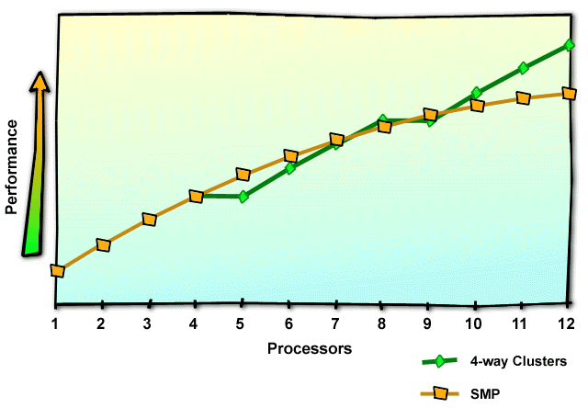
Building Scalable Systems:
Cluster of SMPs (Clumps)

Slide 86
Hardware and Software Trends
Network performance increase of tenfold using 100BaseT Ethernet with full duplex support
The availability of switched network circuits, including full crossbar switches for proprietary network technologies such as Myrinet
Workstation performance has improved significantly
Improvement of microprocessor performance has led to the availability of desktop PCs with performance of low-end workstations at significant low cost
Performance gap between supercomputer and commodity-based clusters is closing rapidly
Parallel supercomputers are now equipped with COTS components, especially microprocessors
Increasing usage of SMP nodes with two to four processors
The average number of transistors on a chip is growing by about 40% per annum
The clock frequency growth rate is about 30% per annum

Slide 87
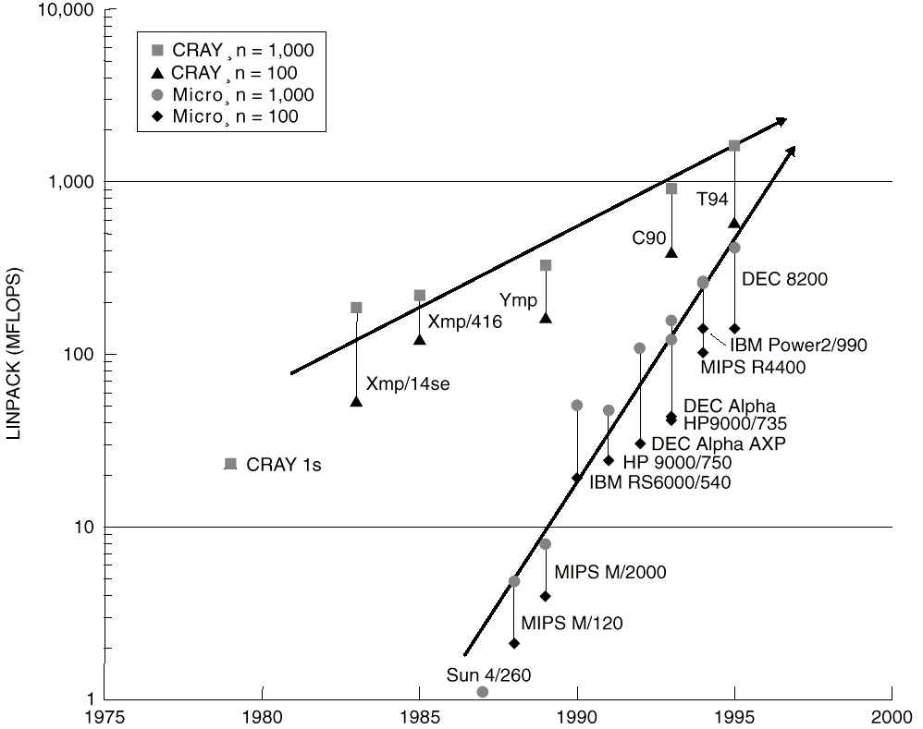
Technology Trend

Slide 88
Advantages of using COTS-based Cluster Systems
Price/performance when compared with a dedicated parallel supercomputer
Incremental growth that often matches yearly funding patterns
The provision of a multipurpose system

Slide 89



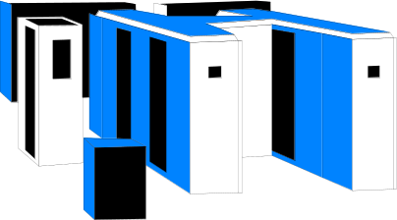

Computing Platforms Evolution
Breaking Administrative Barriers
2100
2100
2100
2100
?
PERFORMANCE
2100
2100
2100
2100
2100
Administrative Barriers
Individual
Group
Department
Campus
State
National
Globe
Inter Planet
Universe
Desktop
(Single Processor)
SMPs or SuperComputers
Local
Cluster
Enterprise
Cluster/Grid
Global
Cluster/Grid
Inter Planet
Cluster/Grid ??

